Slide 1
Signaling in Communication

Slide 2
Objectives
At the end of this session, you will be able to:
  Understand the need of signaling and its categorization
  Understand the types of signaling used in PSTN: CAS, CCS
  Understand the need of CCS over CAS
  Understand common signaling standard called ‘SS7 signaling system’ from a perspective of features and advantages
  Understand SS7 network architectural components such as SSP, SCP and STP and their roles
  Understand PSTN call flow with SS7 network
CONFIDENTIAL© Copyright 2008 Tech Mahindra Limited

Slide 3
Agenda
Signaling classification
Channel Associated Signaling [CAS]
Common Channel Signaling [CCS]
SS7 signaling network features
SS7 signaling network architecture
PSTN call flow using SS7 network
CONFIDENTIAL© Copyright 2008 Tech Mahindra Limited

Slide 4
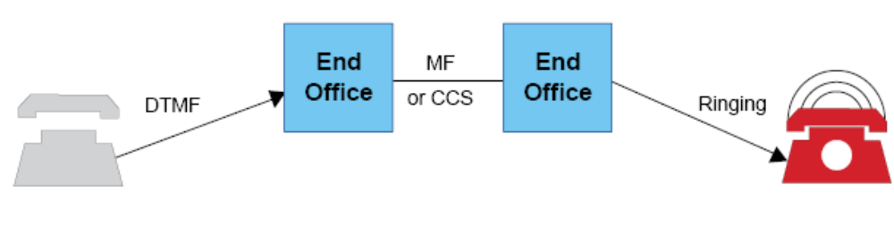
Signaling
Request service from the central office switch
Provide central office switch with the information necessary to route a telephone call
Alert destination address of incoming call
Provide status information and call supervision for billing.
Manage network lines/trunks
CONFIDENTIAL© Copyright 2008 Tech Mahindra Limited

Slide 5

Signaling Categories
4. Seizure
CO
CO
1. Off Hook
4. Wink
5. Ring
2. Dial Tone
3. 555-2345
Supervisory
2. Information
3. Address
4. Control
5. Alerting
CONFIDENTIAL© Copyright 2008 Tech Mahindra Limited
Notes:
Supervisory Signals are from subscriber to initiate or terminate the call or to invoke the facility(offhook onhook)
Information Signal is from exchange to subscriber indicating the progress of the call (tones)
Address Signal from subscriber to exchange or between the exchanges gives the called party number of the facility (destination)
Control Signal between switches to initiate or terminate the call.
Alerting Signal from switch to subscriber indicating the arrival of the call.

Slide 6
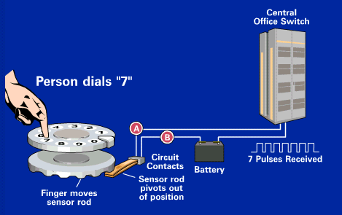
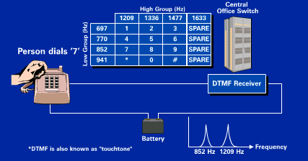
Dial Methodologies
Pulse Dialing
Tone Dialing
CONFIDENTIAL© Copyright 2008 Tech Mahindra Limited
Notes:
Dial tone , ring tone , off hook , on hook are couple of other examples of subscriber local loop signalling.

Slide 7
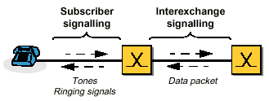
Signaling Context
CONFIDENTIAL© Copyright 2008 Tech Mahindra Limited

Slide 8
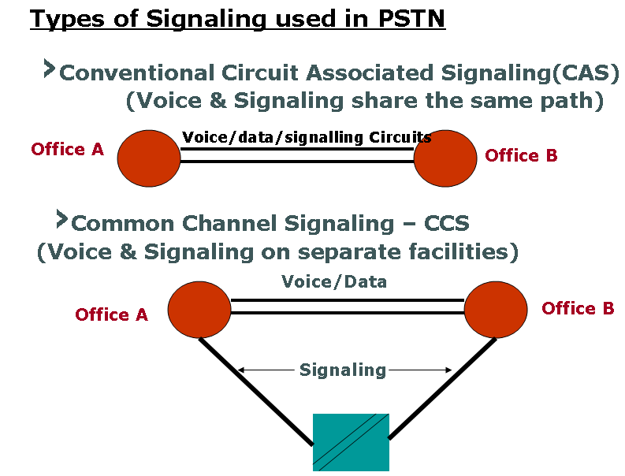
Inter Exchange Signaling
CONFIDENTIAL© Copyright 2008 Tech Mahindra Limited

Slide 9
Channel Associated Signaling
Channel associated Signaling - Line signaling
Signaling for time
Slots 1 and 17
Signaling for time
slots 15 and 31
Signaling for time
slots 2 and 18
Multiframe alignment
16
16
16
16
16
Frame 16
Frame 1
Multiframe
Line signaling in time slot 16
CONFIDENTIAL© Copyright 2008 Tech Mahindra Limited
Notes:
Signaling in circuit-switched networks
- Old signaling systems may also use traffic channels for signaling
Signalling is slow
Information capacity is limited and used inefficiently
Limited or no capacity for non call-related information
Applies to telephony only - cannot cover new services
Signalling capacity reserved for the slot

Slide 10
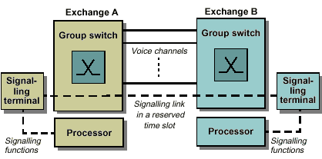
Common Channel Signaling [CCS]
CONFIDENTIAL© Copyright 2008 Tech Mahindra Limited
Notes:
The most modern form of interexchange signalling on circuit-switched connections is common channel signalling (CCS). SS7, which belongs to this category, is predominant in modern digital networks. CCS requires a separate signalling network; that is, the signals have a bearer service of their own. Because the signalling network executes this bearer service, it can be accessed by users other than the PSTN. Other typical users are ISDN and the PLMN.

Slide 11
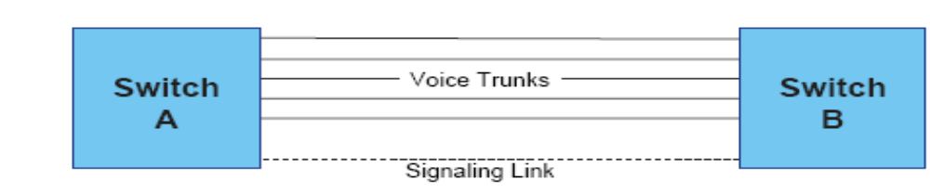
CCS/SS7 FEATURES/Advantages
Features:
  SS7 network is a packet switched network
  Voice channel is dedicated for voice and information signals such as dial tones and announcement
  Signaling channels are on separate network
  Signaling channels carry control, address and supervisory signals
  Signaling network is common to all voice channels
Advantages:
  Greater volume of signaling information with added flexibility
  Reduction in call set up times
  More efficient use of trunks
  Reduction in fraud rate due to separation of signaling and voice path
  Facilitation of additional (transaction based) services
CONFIDENTIAL© Copyright 2008 Tech Mahindra Limited

Slide 12
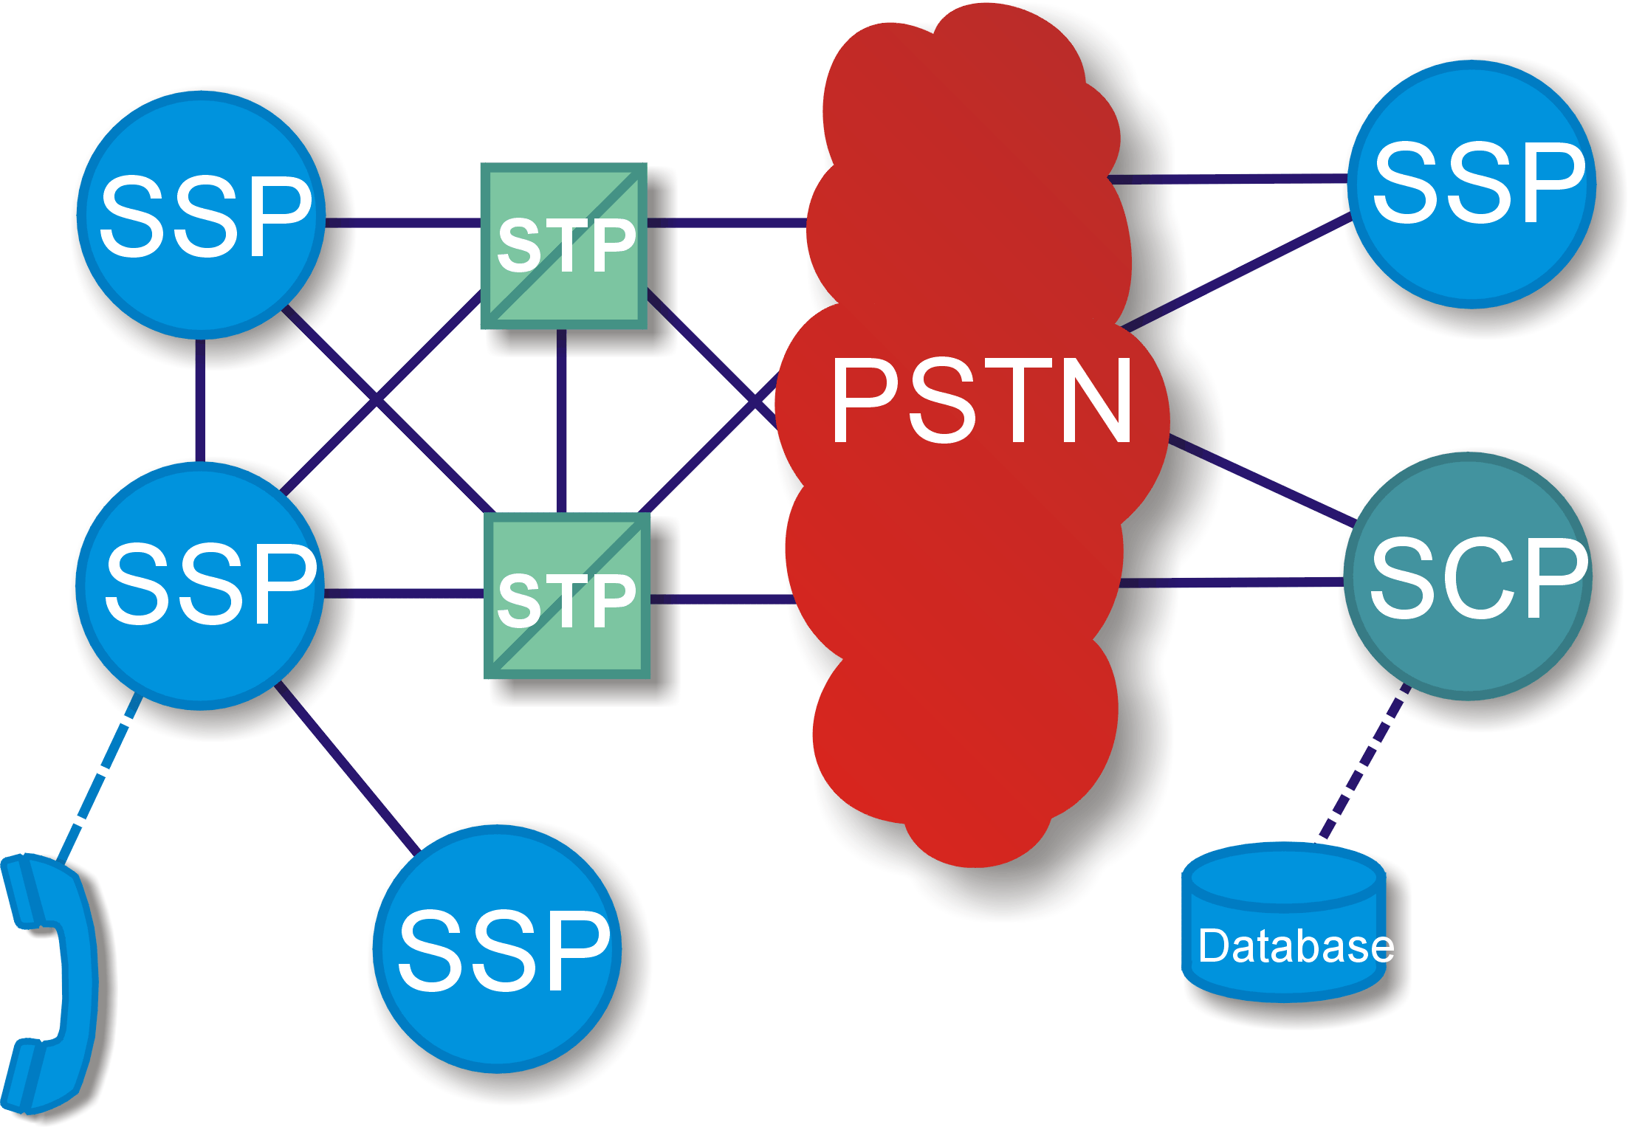

SS7 Network Elements
Service Switching Point
IP
CONFIDENTIAL© Copyright 2008 Tech Mahindra Limited
Notes:
The Service Swiching point or the SSP are telecom switches equipped with SS7-capabile software. They are used to originate, terminate or switch calls

Slide 13

SS7 Network Elements
Signaling Transfer Point
IP
CONFIDENTIAL© Copyright 2008 Tech Mahindra Limited
Notes:
The Signal Transfer Points or the STP receive and route the incoming signaling messages towards the proper destination. They also perform specialized and complex routing functions

Slide 14

SS7 Network Elements
Signaling Control Point
IP
CONFIDENTIAL© Copyright 2008 Tech Mahindra Limited
Notes:
The Signaling Control Point or the SCP is a specialized node in the network that hosts the software and the data for services like
1-800 numbers i.e. toll free numbers
Local number portability , calling cards , prepaid etc. Note that a database is associated with SCP

Slide 15


SS7 Network Elements
Signaling Link
IP
Intelligent Peripheral
CONFIDENTIAL© Copyright 2008 Tech Mahindra Limited
Notes:
The Intelligent Peripheral or the IP is the node that provides the IVR (interactive voice resource) functionalities. It plays announcements and prompts and collects user information.
All the nodes in an SS7 network are connected via signaling data links with varied specification.

Slide 16
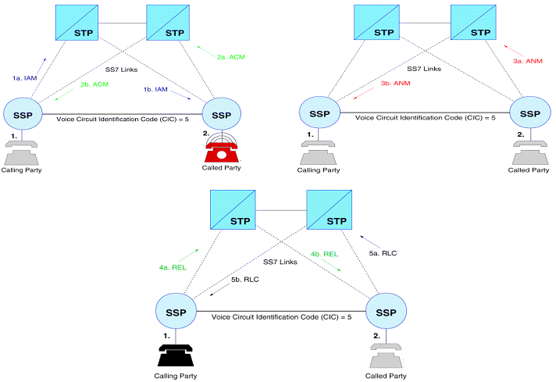
Basic ISUP Signaling
CONFIDENTIAL© Copyright 2008 Tech Mahindra Limited
Notes:
Sequence of call set up.
1.IAM = Initial Address message .required destination number is sent to destination SSP via its own STP by reserving a Trunk (Ckt no5 in this case).
2.Upon confirming the required number is available the destination side SSP2 confirms to calling SSP1 by a ACM=Address complete message through its own associated STP,by reserving the Trunk ckt 5..
Called party fed Ring by SSP2 while SSP1 after receiving ACM feeds Ring back tone (RBT) to Calling party.
3.When called subscriber Answers by lifting his hand set SSP2 sends ANM=Answer Message to SSP1 & removes ring to called subscriber.SSP2 upon receiving ANM removes the RBT to caller & now both parties will be connected by SSP1/SSP2 on Ckt 5.
4.When either party disconnects(in figure party1 disconnects) a REL = Release message is sent to destination SSP(SSP2) asking for release of call by disconnecting CKt 5.
5.SSP2 after disconnection sends back a RLC =Release complete message to SSP 1 Confirming release of Circuit.
Ckt 5 is now available for other calls

Slide 17
Summary
In this session, we have learned:
  Need of signaling and its categorization
  Types of signaling used in PSTN: CAS, CCS
  CCS v/s CAS
  SS7 CCS: Features and advantages
  SS7 network architectural components such as SSP, SCP and STP and their role in networking
  PSTN telephone call flow using SS7 network
CONFIDENTIAL© Copyright 2008 Tech Mahindra Limited

Slide 18
Thank You

